Slide 1
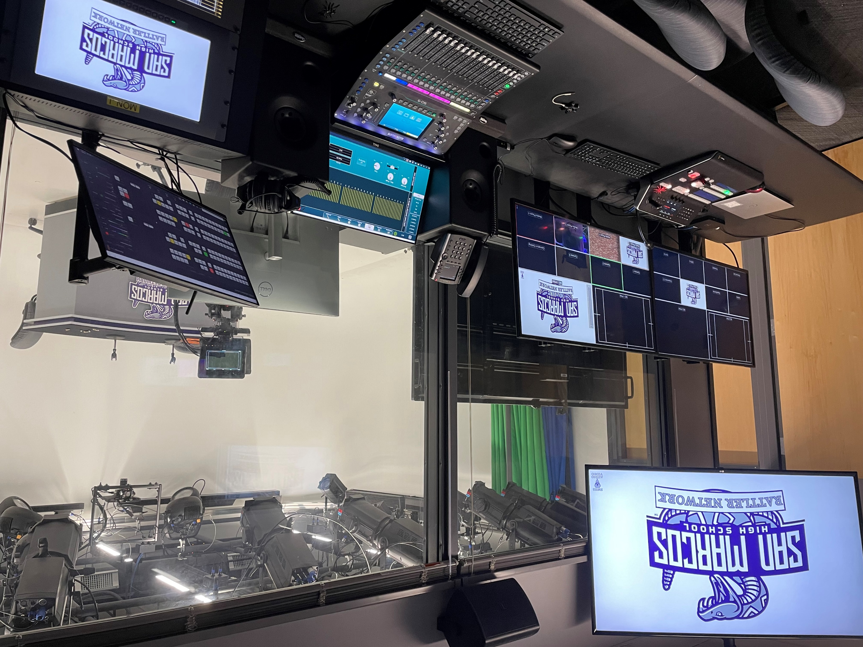
Digital Communications
Statewide Program of Study
Arts, Audio/Video Technology, and Communications Career Cluster
The Arts, A/V Technology and Communications (AAVTC) Career Cluster focuses on careers in designing, producing, exhibiting, performing, writing, and publishing multimedia content including visual and performing arts and design, journalism, and entertainment services. Careers in the AAVTC career cluster require a creative aptitude, a strong background in computer and technology applications, a strong academic foundation, and a proficiency in oral and written communication.
The Digital Communications program of study explores the occupations and educational opportunities associated with the production of audio and visual media formats for various purposes, such as TV broadcasts, advertising, video production, or motion pictures. This program of study may also include exploration into operating machines and equipment to record sound and images, such as microphones, sound speakers, video screens, projectors, video monitors, sound and mixing boards, and related electronic equipment.
Work-Based Learning and
Expanded Learning Opportunities
Secondary Courses for High School Credit
1 Principles of Arts, Audio/Video Technology, and Communications
2 Audio/Video Production I
3 Audio/Video Production II
4 Practicum in Audio/Video Production
Exploration Activities | Work-Based Learning Activities
Shadow a production team Participate in SkillsUSA | Intern at a local television station or video production company Work with a local company on a project
Industry-Based Certifications
Adobe Certified Professional in Digital Video Using Adobe Premiere Pro
Postsecondary Opportunities
Associates Degrees
Recording Arts Technology/Technician
Cinematography and Film/Video Production
Radio and Television Broadcasting Technology/Technician
Music Technology
Bachelor’s Degrees
Recording Arts Technology/Technician
Cinematography and Film/Video Production
Radio and Television
Agricultural Communication/Journalism
Master’s, Doctoral, and Professional Degrees
Communications Technology/Technician
Cinematography and Film/Video Production
Radio and Television
Agricultural Communication/Journalism
SMHS Rattler Broadcast Studio
Aligned Occupations
Occupations | Median Wage | Annual Openings | % Growth
Sound Engineering Technicians | $39,562 | 79 | 27%
Camera Operators, Television, Video, and Motion Picture | $50,024 | 129 | 9%
Audio and Video Equipment Technicians | $40,581 | 757 | 29%
Film and Video Editors | $47,382 | 118 | 23%
Successful completion of the Digital Communications program of study will fulfill requirements of the Business and Industry endorsement. Revised – August 2022

Slide 2
Digital Communications Course Information
COURSE NAME | SERVICE ID | PREREQUISITES | COREQUISITES
Principles of Arts, A/V Technology, and Communications | 13008200 (1 credit) 6356 | None | None
Audio/Video Production I | 13008500 (1 credit) 6390 | Principles of Arts, A/V Tech, and Comm. | None
Audio/Video Production II | 13008600 (1 credit) 6362 | Audio/Video Production I | None
Practicum in Audio/Video Production | 13008700 (2 credits) 6363 | Audio/Video Production II/Lab | None
FOR ADDITIONAL INFORMATION ON THE ARTS, AUDIO/VIDEO TECHNOLOGY, & COMMUNICATIONS CAREER CLUSTER,
PLEASE CONTACT: CJ Odam, SMCISD CTE Coordinator cj.odam@smcisd.net
San Marcos CISD does not discriminate on the basis of race, color, national origin, sex, disability or age in its programs or activities and provides equal access to the Boy Scouts and other designated youth groups. The following person has been designated to handle inquiries regarding the nondiscrimination policies: Stephanie Munoz ; 631 Mill St, San Marcos, TX 78666 ; 512-393-6700 ; stephanie.munoz@smcisd.net
Further nondiscrimination information can be found at smcisd.net/cte

